Slide 1
BehavIoral Health Commission
Meeting
Sheriff Karl Leonard
and
Kerri Rhodes LPC, LMFT

Slide 2
Ground Truth
The Frontline of the Mental Health Crisis

Slide 3
THE MENTAL HEALTH CRISIS: Understanding the Battle we are FIGHTING

Slide 4
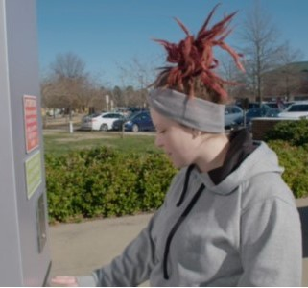
Landmines and Rescue Missions
Understanding Gaps and Finding Solutions

Slide 5
Way Forward
Chesterfield County Jail
Purpose: House criminals
Staff: Deputies

Slide 6
Way Forward
Chesterfield County Jail
Chesterfield County Psychiatric Hospital
Purpose: House criminals
Staff: Deputies
Purpose: Treat the mental health issues
Staff: Multi-disciplinary Treatment Team

Slide 7
Way Forward
Chesterfield County Jail
Chesterfield County Psychiatric Hospital
Purpose: House criminals
Staff: Deputies
Purpose: Treat the mental health issues
Staff: Multi-disciplinary Treatment Team

Slide 8
TARGET ACQUISITION
Prevention
Intervention
treatment
Resources
Recovery
MENTAL
HEALTH

Slide 9
Unified Command

Slide 10
“There comes a point where we need to stop just pulling people out of the river. We need to go UPSTREAM and find out why they’re falling in.”
~Desmond Tutu

